Slide 1

City Genie
SREYAS INSTITUTE OF ENGINEERING & TECHNOLOGY
(AUTONOMUS)
(Approved by A.I.C.T.E.,New Delhi., Affiliated to JNTUH Hyderabad, Accredited by NAAC ‘A’ Grade & NBA)
DEPARTMENT OF COMPUTER SCIENCE ENGINEERING(AI&ML)
Group – 16
Team Members:
Sameeksha - 23VE1A6642
Yashwitha - 23VE1A6637
Pravalika - 23VE1A6639
Siri - 23VE1A6618
Sreehitha - 23VE1A6616

Slide 2
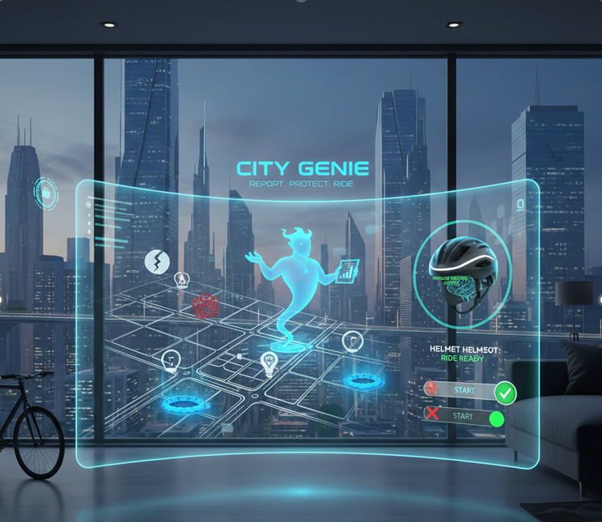
Problem Statement:
City Genie is a futuristic, interactive web platform where citizens can report city hazards like potholes, blockages, missing streetlights, and open bore wells through an interactive map. The system also integrates smart bike helmet sensors, ensuring bikes only start when riders wear helmets

Slide 3
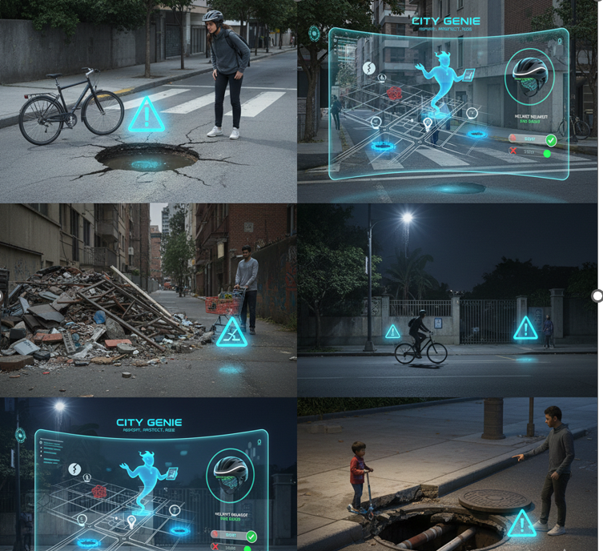
Introduction
Enables citizens to easily report city hazards like potholes, blockages, missing streetlights, and open bore wells.
Helps prevent accidents and loss of life by identifying issues early.
Promotes faster response and efficient action from municipal authorities.
Improves road safety through smart bike helmet sensors that ensure helmet compliance.
Reduces severe injuries and fatalities caused by road accidents.
Encourages active citizen participation in city development.

Slide 4

Objectives:
To provide a user-friendly platform for citizens to report urban hazards through an interactive map.
To ensure timely identification and resolution of city infrastructure issues.
To improve public safety by reducing accidents caused by road and environmental hazards.
To promote road safety by integrating smart helmet sensors with bike ignition systems.
To enforce helmet usage and reduce injuries and fatalities in road accidents.
To encourage active citizen participation in urban governance.

Slide 5

Key Features
Interactive map-based hazard reporting
Real-time issue tracking and updates
Smart helmet sensor integration
Secure and user-friendly interface
Data collection for analytics and planning

Slide 6

Solution
Provides an interactive map for citizens to report city hazards like potholes, blockages, missing streetlights, and open bore wells.
Ensures real-time tracking and updates for reported issues, helping authorities act quickly.
Integrates smart helmet sensors with bikes to enforce helmet usage before ignition.
Promotes road safety by reducing accidents caused by non-compliance with helmet laws.

Slide 7
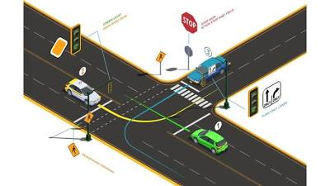
Advantages
Improves Public Safety: Reduces accidents and injuries by reporting hazards and enforcing helmet usage.
Faster Issue Resolution: Enables authorities to respond quickly to reported problems.
Encourages Citizen Participation: Empowers residents to contribute to city maintenance and governance.
Promotes Road Safety: Smart helmet sensors ensure compliance, lowering accident risks.
Data-Driven Decision Making: Collected reports help authorities prioritize and plan urban development.

Slide 8
Conclusion
City Genie is a comprehensive solution for building safer, smarter, and more responsive cities. By combining citizen-driven reporting with smart technology like helmet sensors, it ensures hazards are identified and addressed promptly while promoting road safety. The platform strengthens collaboration between residents and municipal authorities, improves transparency, and supports data-driven urban planning. Overall, City Genie empowers citizens, enhances public safety, and contributes to the development of sustainable, well-managed, and technologically advanced urban environments.

Slide 9


